Slide 1


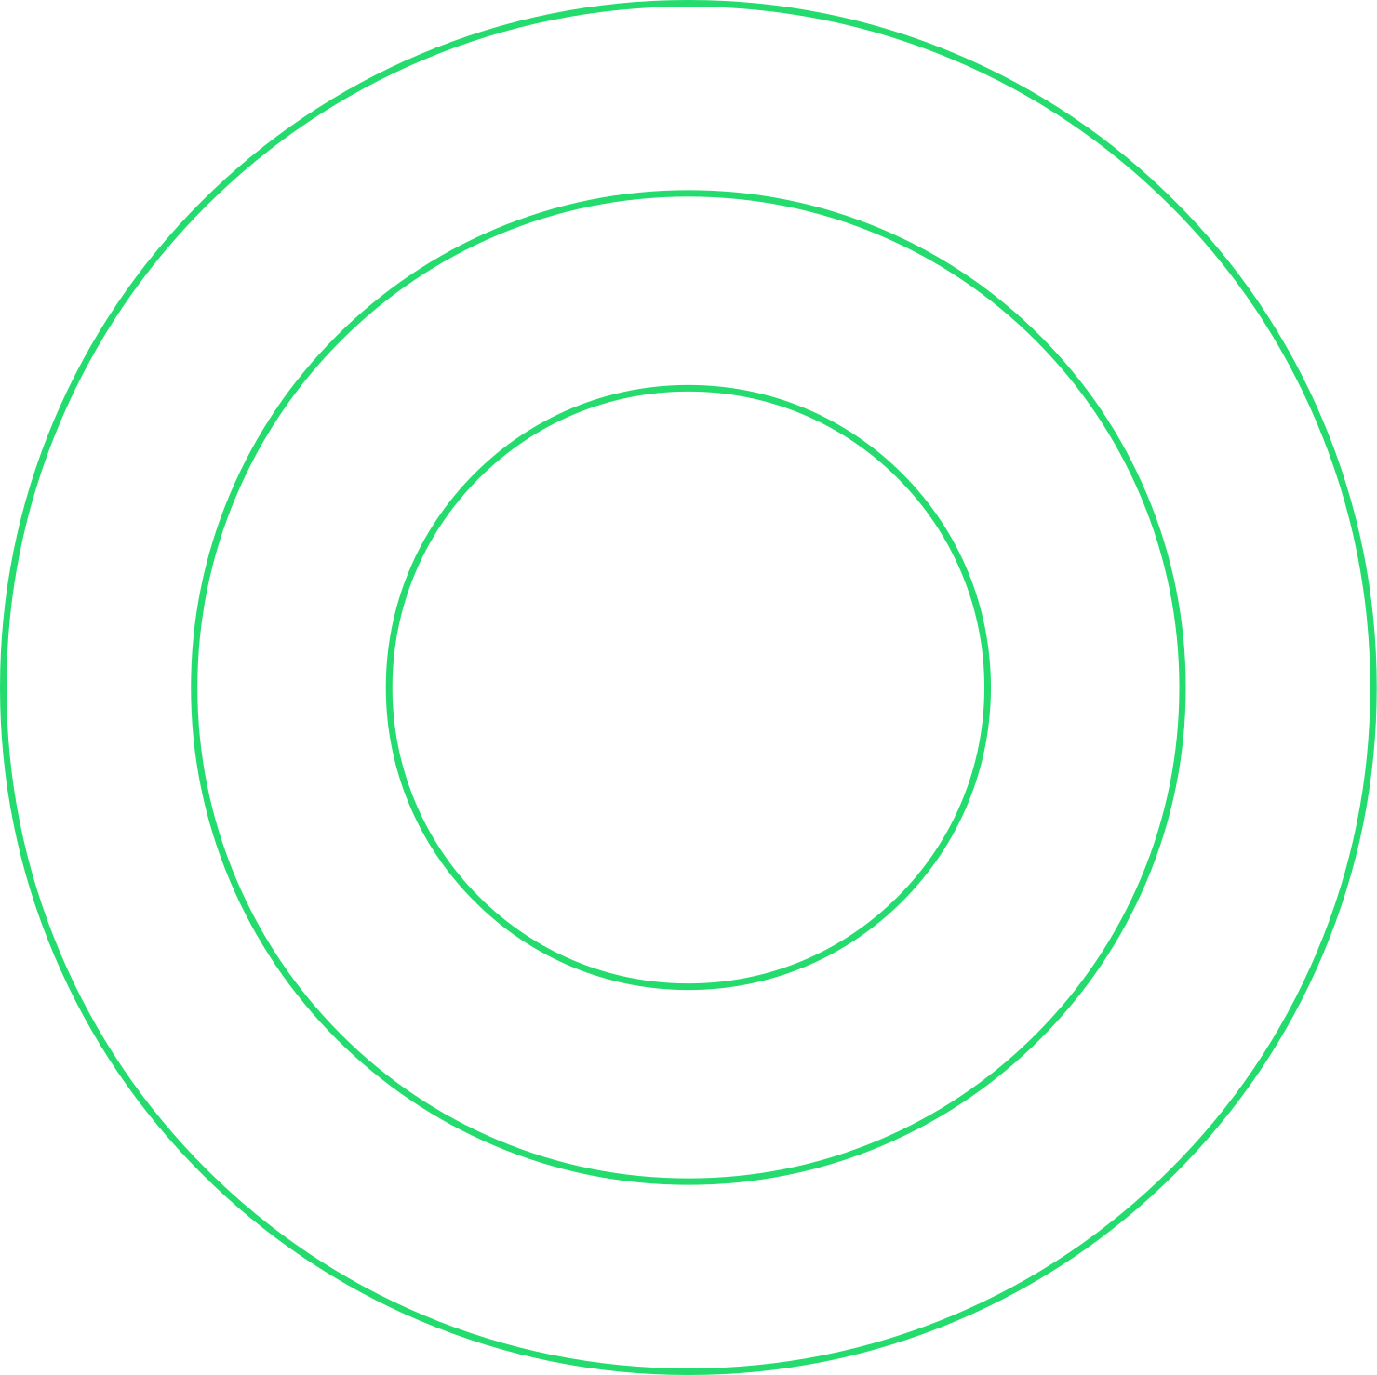

PROJECT 1
From TikTok
to Top Charts
Analyzing Its Influence on
Spotify & YouTube Trends

Slide 2


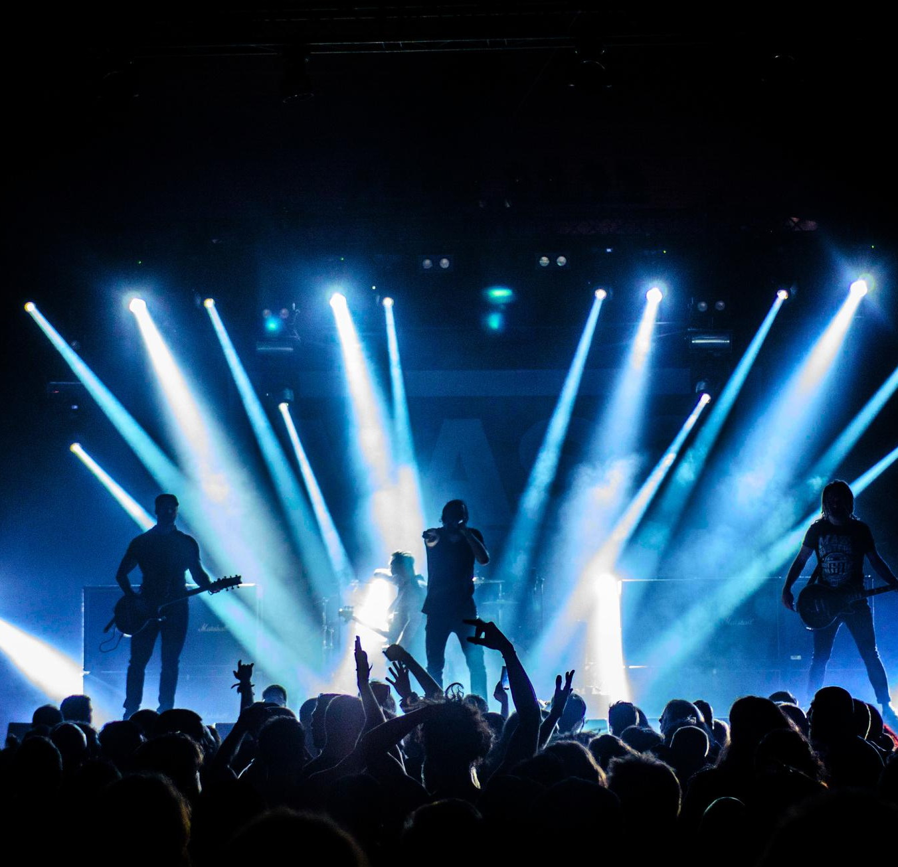

Top Artists
Dina Rodrigues
Jameson McLendon
Patrick Trepanier
Quinton Stibbins
Sarah Ryan

Slide 3

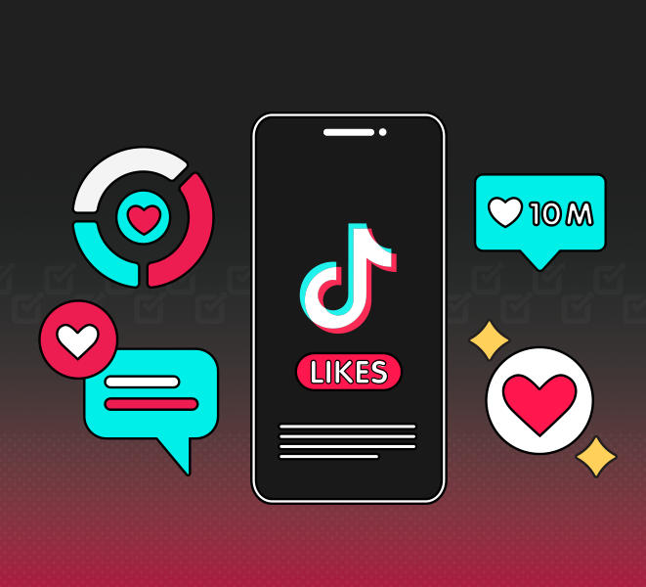
Does TikTok Virality Drive Streaming Success?
Notes:
Jameson: TikTok has become a major force in shaping modern culture. Songs that gain traction on the platform can experience explosive popularity. TikTok’s algorithm-driven nature allows snippets of songs to spread rapidly. This cycle has made TikTok a key player in music discovery, with many artists using the platform to reach wider audiences.
Given its impact, we wanted to explore whether TikTok’s influence translates into true streaming success. Does a song’s popularity on TikTok lead to proportional growth on Spotify or Youtube, or do viral moments fade without long-term impact? To answer this question, we analyzed data across these platforms, comparing TikTok engagement with streaming performance to determine whether going viral truly drives success.

Slide 4


Spotify Data
“Most Streamed
Spotify Songs 2024”
Pulled from Kaggle dataset
Contains information on:
track details (name, artist, album, release date),
popularity metrics (all-time rank, track score, Spotify streams, playlist count, playlist reach, and popularity score), and
engagement across platforms (YouTube views, likes, playlist reach, and TikTok posts, likes, and views).
Notes:
Jameson

Slide 5

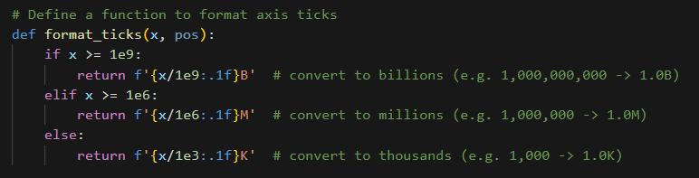

Data Cleaning Process
Step 1: Initial Data Exploration
Step 2: File Preparation
Step 3: Selecting Relevant Data
Step 4: Handling Missing Data
Step 5: Data Type Verification & Conversion
Notes:
Jameson:
Step 1: Initial Data Exploration
Examined the full dataset to understand its structure and potential issues.
Narrowed the focus to a sample of 500 rows for testing.
Further refined by analyzing a subset of 10 rows to ensure accuracy.
Step 2: File Preparation
Converted the original Excel file to a CSV format for easier processing.
Step 3: Selecting Relevant Data
Chose only the necessary columns for our analysis.
Renamed columns for clarity and easy reference.
Step 4: Handling Missing Data
Counted the number of rows before cleaning.
Removed rows containing NaN (missing values).
Recounted to ensure data integrity.
Step 5: Data Type Verification & Conversion
Checked data types to confirm compatibility for analysis.
Converted numerical columns (Spotify streams & TikTok views) to numeric format.

Slide 6
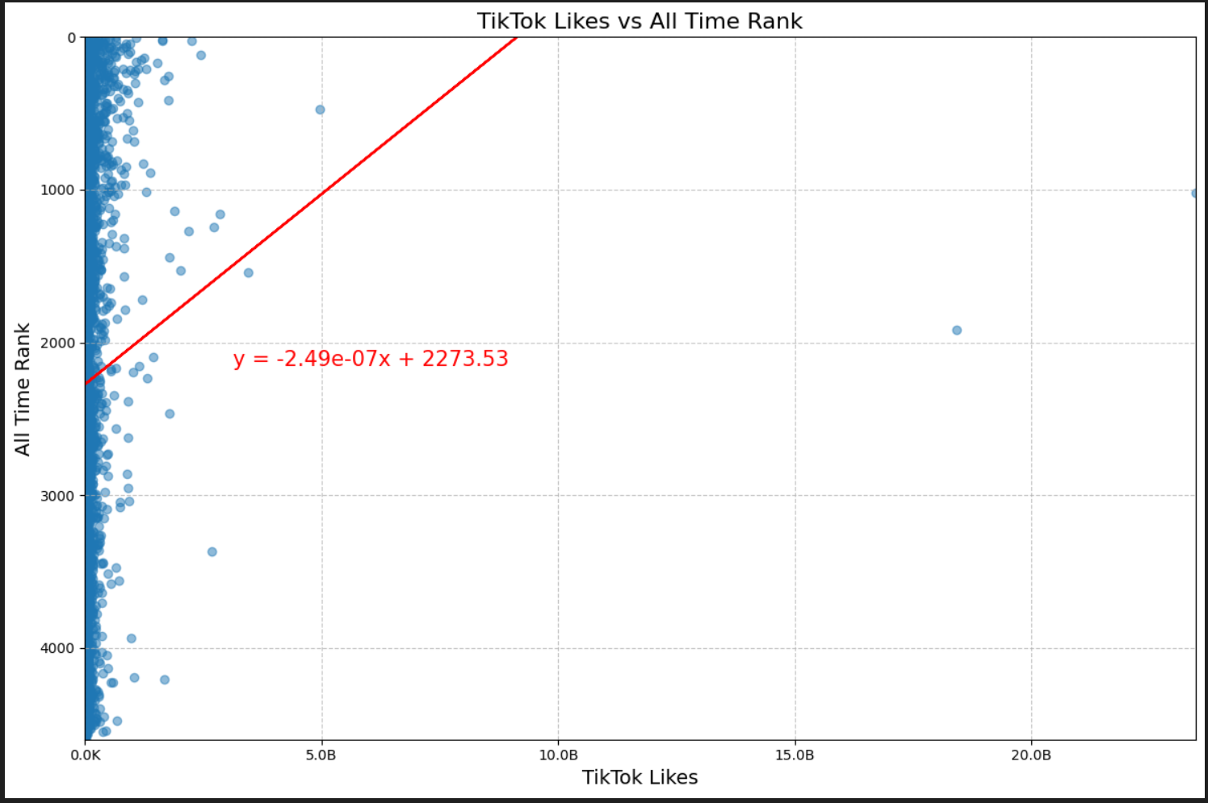
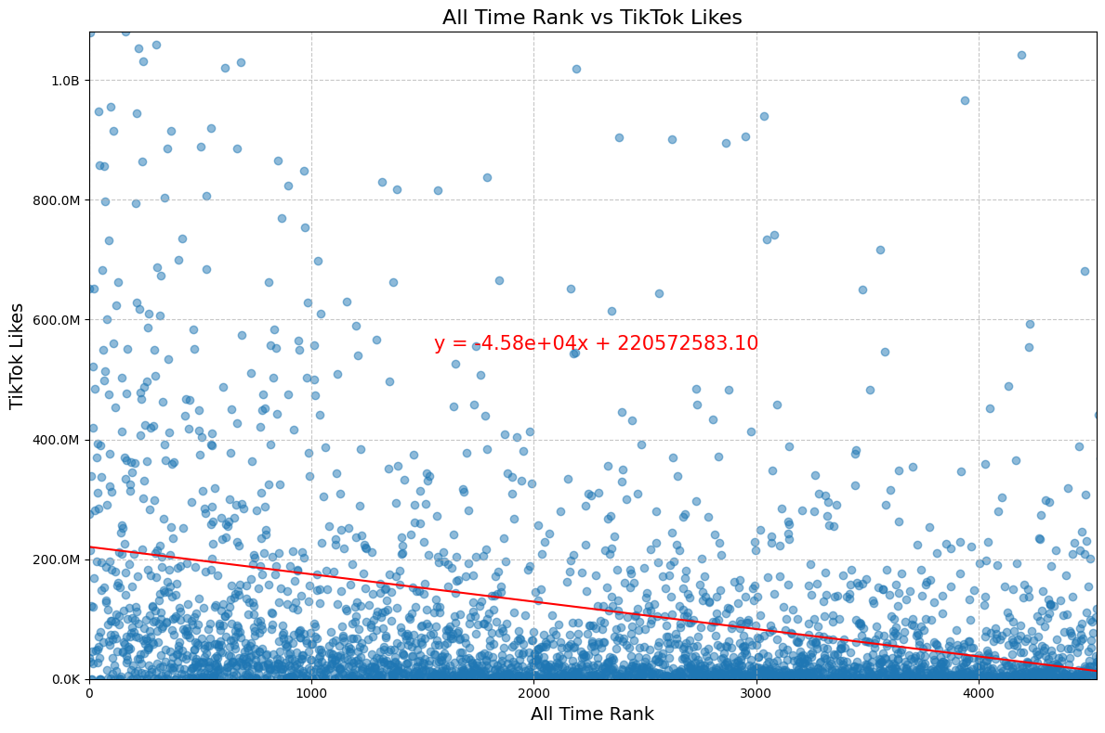
Analysis of All Data
Notes:
Dina: Typically when making a marketing budget or campaign, the goal is to aim for the top spots in the charts for the most visibility and return on investment. This means it is important to understand the overall market for a particular platform, but more importantly understand top chart trends for the platform before investing. When we initially looked at the data, we were under the assumption that TikTok would be leading the trends in what songs became popular, but as we reviewed the data, we saw that other platforms were more predictive. Starting with Spotify data, we see here that using TikTok Likes VS All Time Rank, TikTok’s correlation was opposite to predictive, whereas flipping the control to Spotify All Time Rank shows a stronger and more evenly distributed trend.

Slide 7


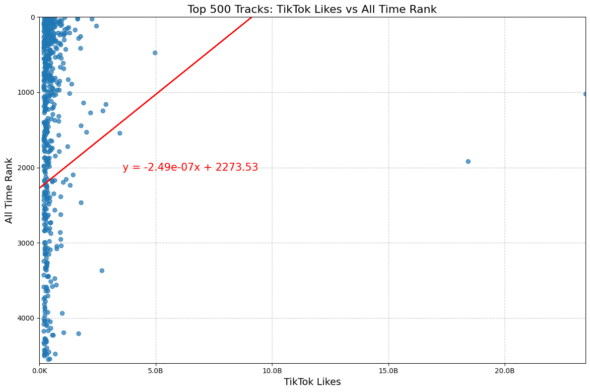
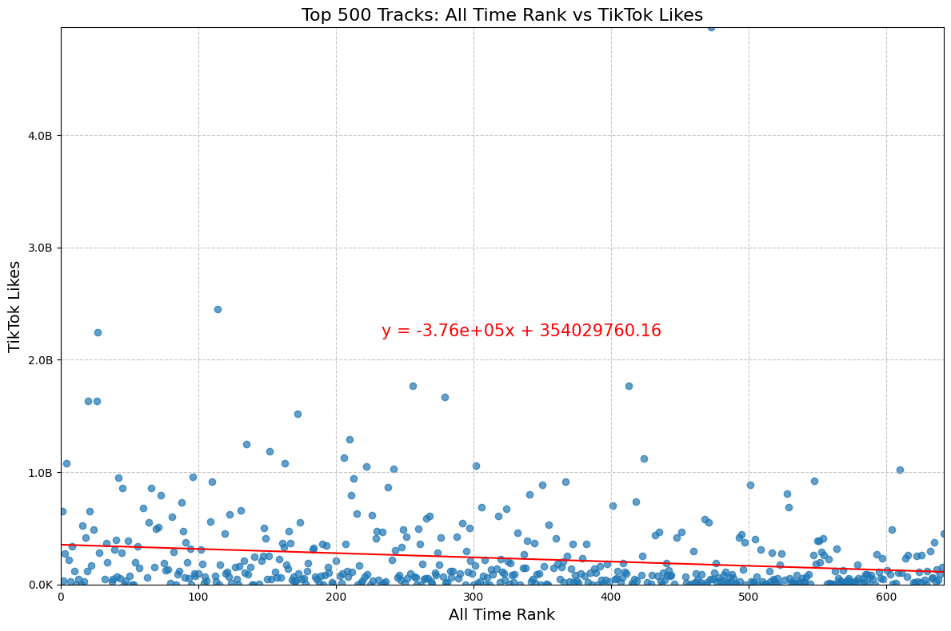
Breakdown of Top 500 TikTok
Likes
Notes:
Dina: In order to confirm the previous findings, we zoomed in further and looks at Top 500 songs for TikTok and Spotify. The trend continued that Spotify was a trendsetter.

Slide 8
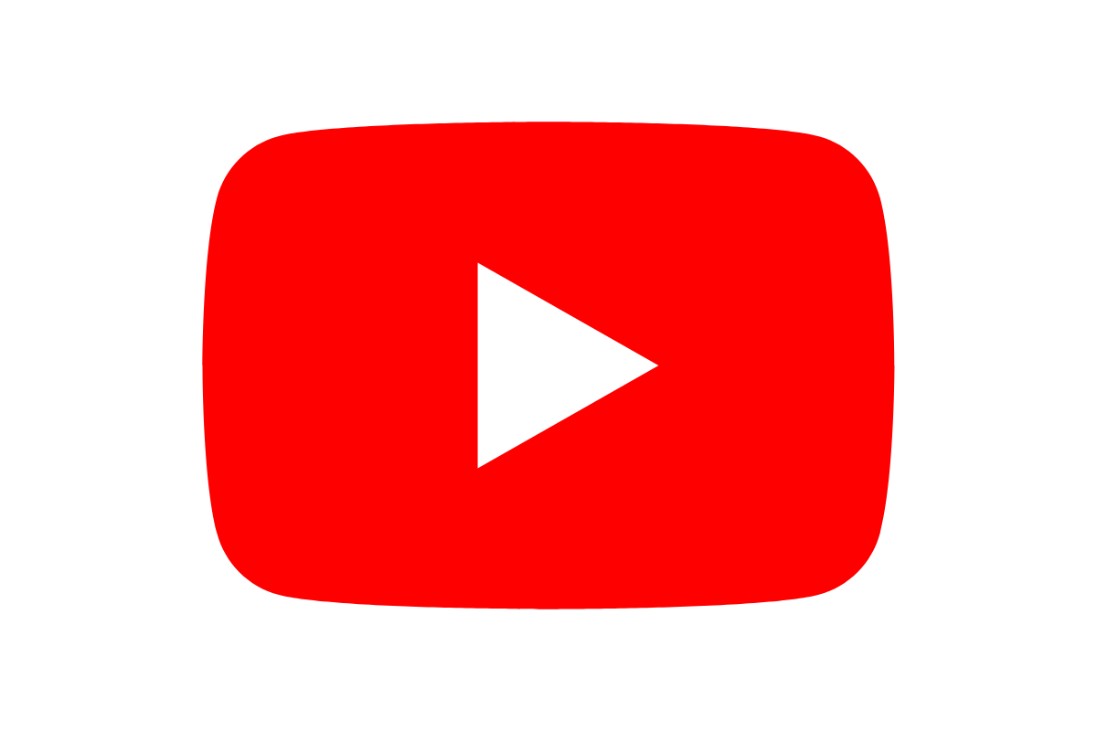
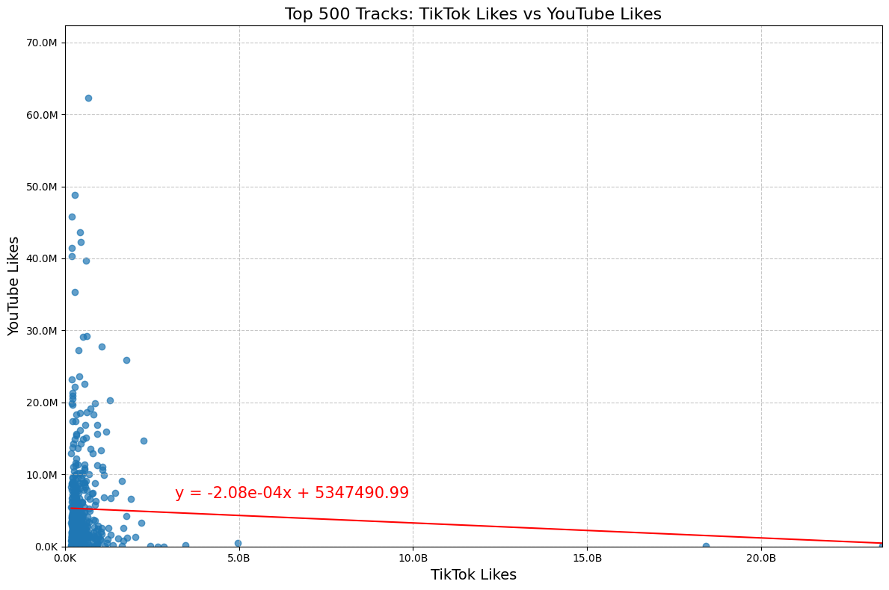
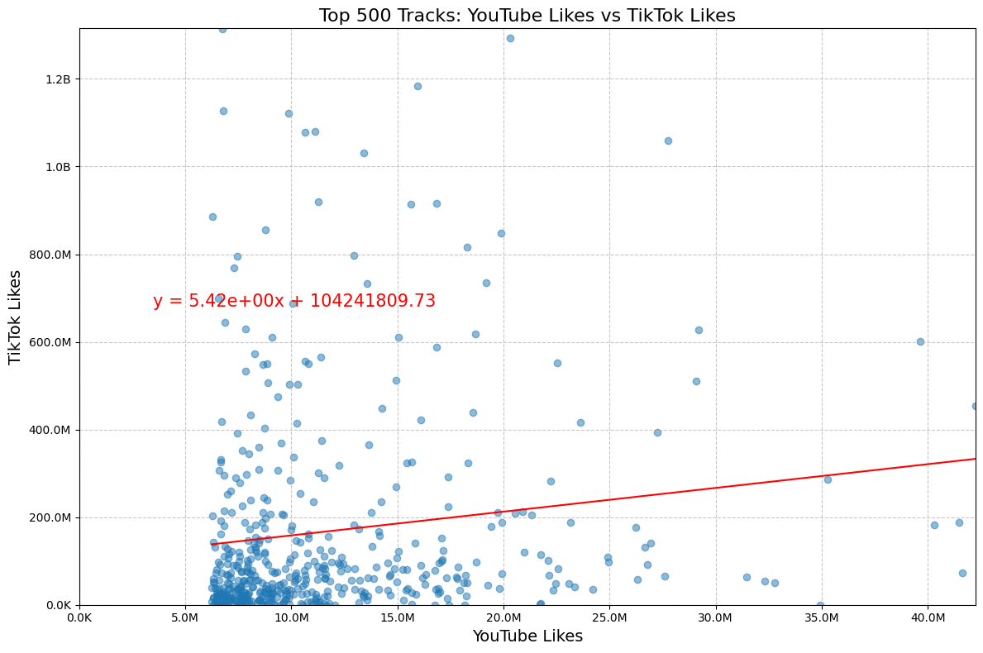
Breakdown of Top 500 TikTok
Likes
Notes:
Dina: Looking at TikTok versus Youtube Like, same trend where YouTube was a stronger determiner.

Slide 9
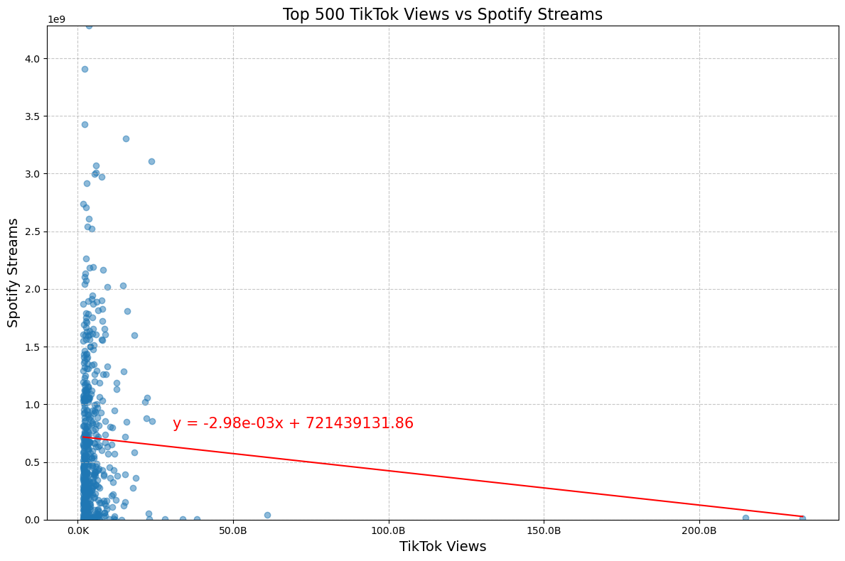
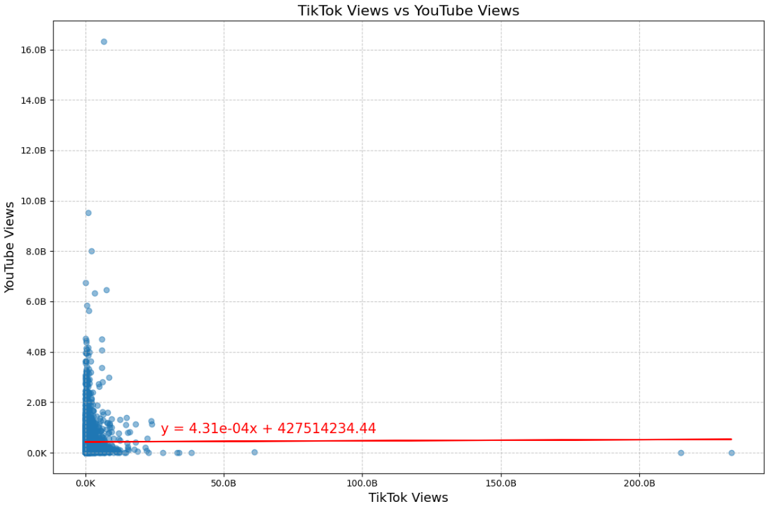
Breakdown of Top 500 TikTok
Views
Notes:
Dina: When comparing between Spotify and Youtube against TikTok, interestingly, the TikTok data behaved rather similarly. So we decided to continue to zoom in further and explore Spotify and YouTube more.

Slide 10


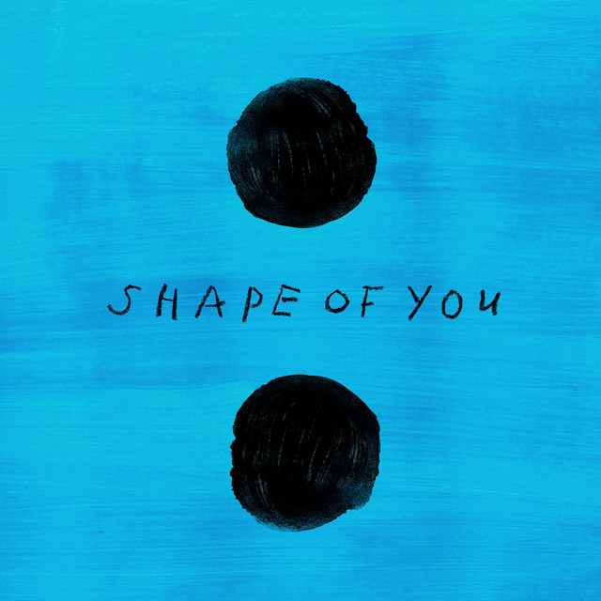







Comparing the Top 10 Rankings
All
Music
Podcasts
Audiobooks
Monkeys Spinning Monkeys
Love You So
Shape of You
Blinding Lights
love nwantiti
(ah ah ah)
Funny Song
Sunflower
Stay
Notes:
Patrick
As we looked at Top 10 rankings across the different services and how they compared to the Top 10 rankings for TikTok, we noticed that while the other platforms tended to have some overlap or familiar names, TikTok created an environment for huge performance from songs that sometimes had little to no impact elsewhere.
Songs like “Monkeys Spinning Monkeys” is a great example of this, accounting for almost a third of Top 10 song plays on TikTok, while barely counting for a third of a percent over on YouTube.
One explanation for this could be that songs on TikTok are often used as more of a soundtrack to the video content, as opposed to the song being the main source of entertainment.

Slide 11
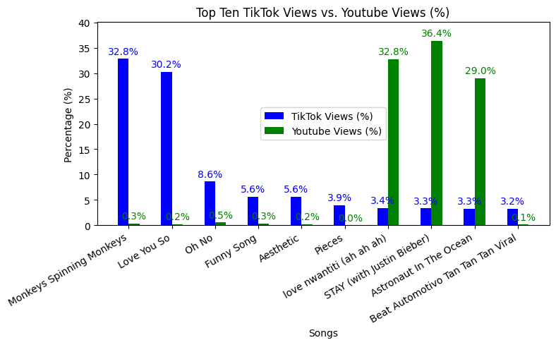
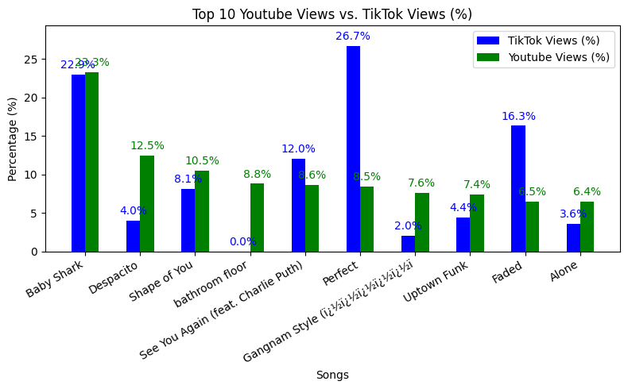
Comparing Top 10 Rankings
TikTok Views vs. YouTube Views
Notes:
Patrick
In comparing the Top 10 TikTok Views vs YouTube views, we continued to see that high performers on TikTok generally didn’t do as well on YouTube, and that a majority of the TikTok views were concentrated in the Top 2 songs.
With the TikTok Top 10 as the control, the resulting bar graph essentially displayed opposites between the platforms, but not a true inverse relationship.
~TikTok as X Axis = opposites
With the YouTube Top 10 as the control, we start to see some more correlation from TikTok, while not entirely consistent, a bit of a connection can be identified. While the TikTok extremes are still present here, we do get a rare near alignment for the top song.
~YouTube as X = some correlation

Slide 12

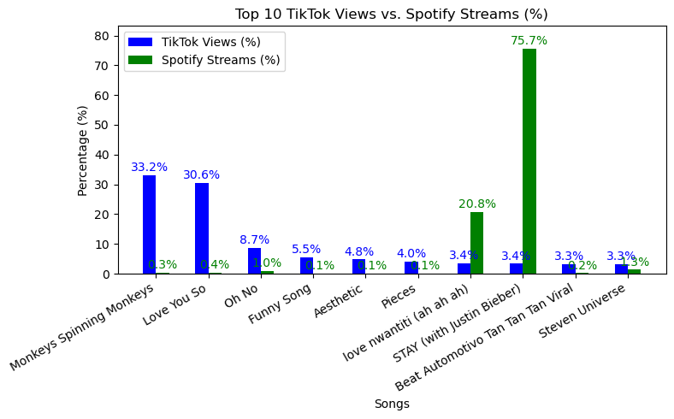
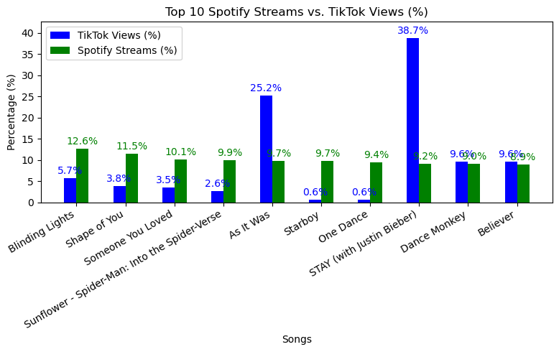
Comparing Top 10 Rankings
TikTok Views vs. Spotify Streams
Notes:
Patrick
TikTok seems to be a service of extremes, with it’s Top 10 having 2 songs being significantly higher than the next 8. Even with the 2 songs that are in the Top 10 on TIkTok that have presence on Spotify are higher by orders of magnitude.
Spotify’s decline from 1 to 10 is more gradual and predictable, and the TikTok data even gets a little less drastic in this chart, though a couple TikTok extremes are present here as well.
*bonus observation
Justin Bieber just seems to succeed everywhere.

Slide 13

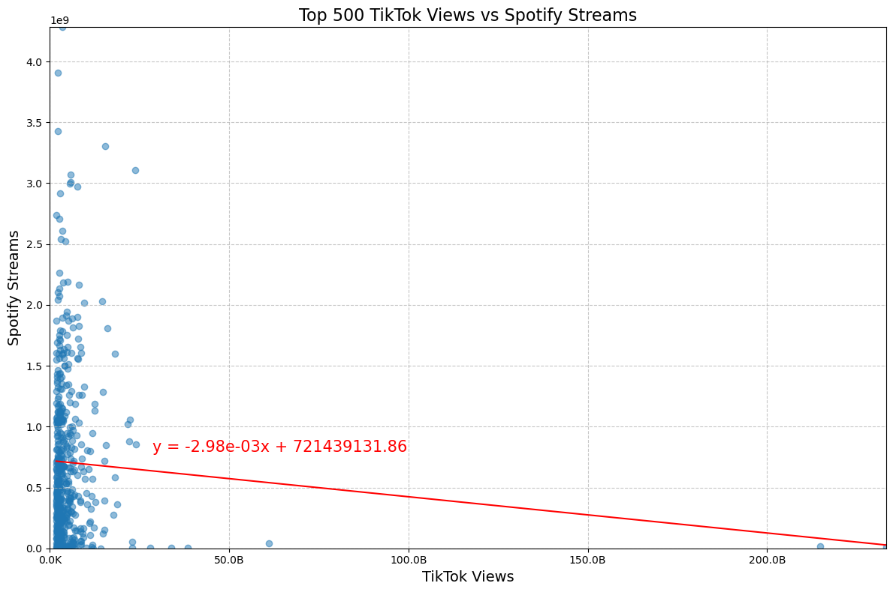
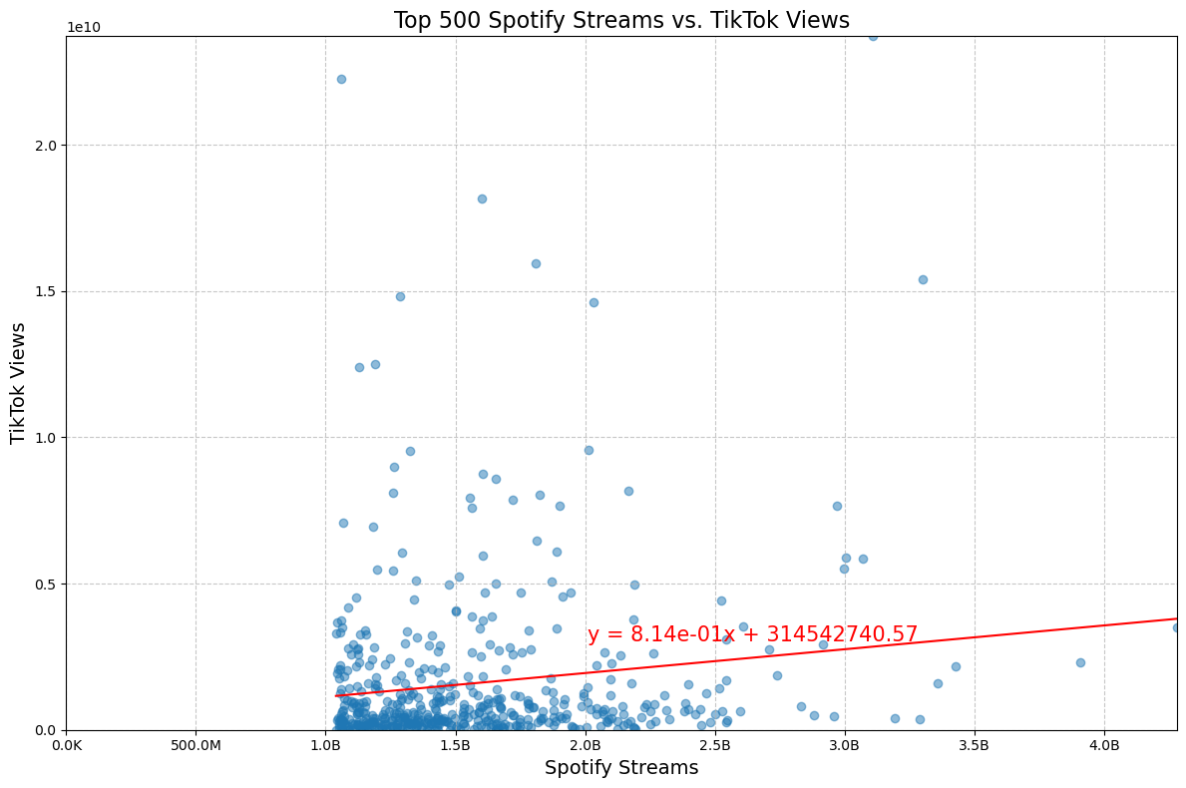

Switching the Control: Spotify as the Baseline
R-squared: 0.0041
R-squared: 0.0210
Notes:
Sarah
Switching the Control: What We Discovered
When we initially used TikTok as the control variable, we were examining how TikTok popularity translated into Spotify streams.
However, we decided to flip the perspective—making Spotify the control—to see if the relationship between the two platforms looked any different.
What Changed in the Scatterplots?
With Spotify as the control, we noticed a slight upward trend in the data, showing that as Spotify streams increased, TikTok views also tended to rise.
But the r² value remained below 0.1, meaning the correlation between the two variables was still weak.
Essentially, a song’s success on Spotify does not strongly predict its virality on TikTok.
Key Difference: Data Spread
Previously, when TikTok was the control, the data was more concentrated—suggesting that viral TikTok songs had varying levels of success on Spotify.
Now, with Spotify as the control, TikTok views are much more spread out.
This tells us that while some songs do well on both platforms, the relationship is inconsistent.
A high number of Spotify streams doesn’t necessarily mean a song will go viral on TikTok.
Challenging the Assumption About TikTok’s Influence
This analysis challenges the common belief that TikTok is the main driver of streaming success.
Instead, it suggests that while TikTok can contribute to a song’s popularity, long-term streaming performance may be influenced by other factors—like artist reputation, playlist placements, or traditional marketing efforts.

Slide 14

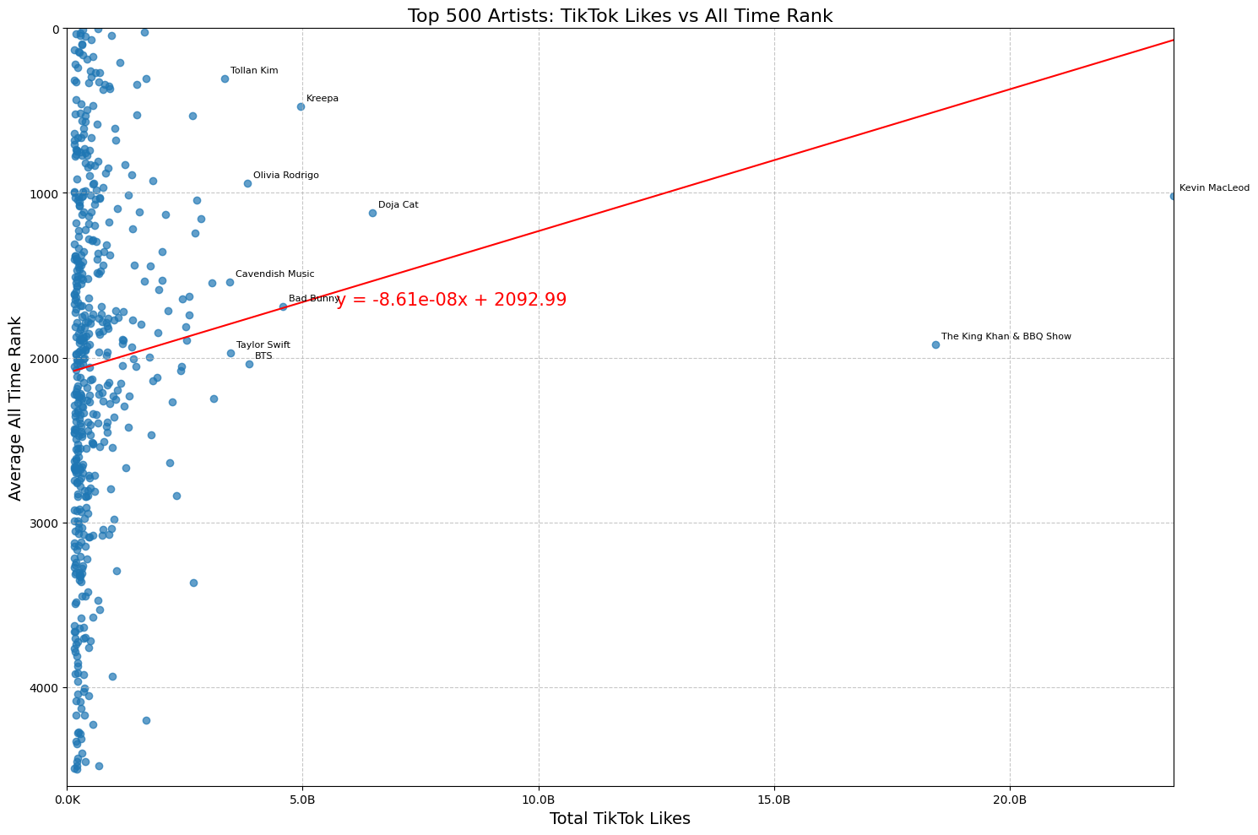
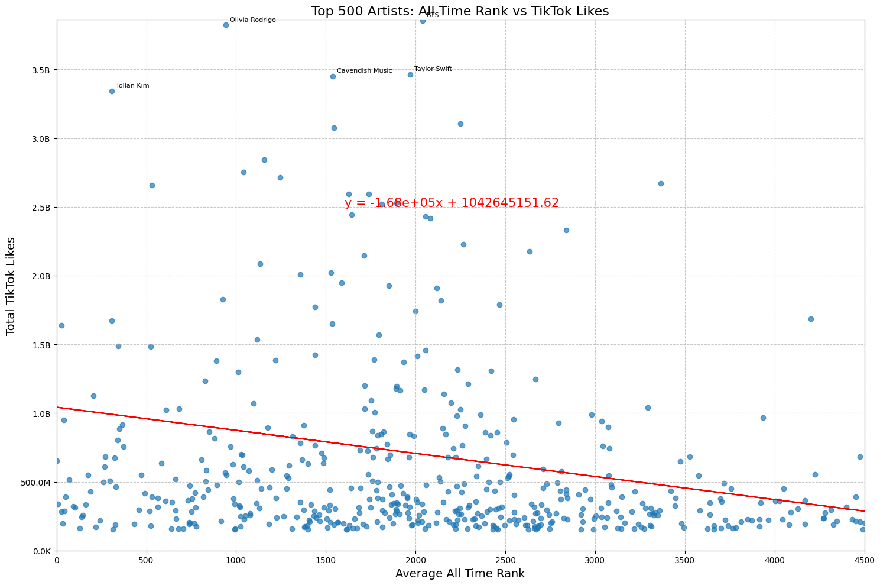
Top 500 Artists
Notes:
Sarah
For this analysis, we shifted the control to TikTok likes and examined how they relate to an artist’s average all-time rank on Spotify. One key observation is that the y-axis represents rank, with 0 being the highest rank and 4400 being lower-ranked artists.
Understanding the Trend At first glance, the trendline appears positive, but because the y-axis is inverted (with lower numbers representing higher rankings), the actual slope is negative. This suggests that artists with more TikTok likes tend to have better (lower) all-time ranks on Spotify. In other words, higher TikTok engagement is associated with stronger long-term streaming success.
What This Tells Us
Even though the relationship isn’t necessarily strong, it indicates that TikTok engagement correlates with an artist’s long-term performance on Spotify, rather than just short-term viral boosts.
However, since the slope isn’t steep, it also suggests that TikTok success alone doesn’t guarantee a top-tier all-time rank—other factors like catalog size, sustained listenership, and playlist placements may also play a role.
Top 10 Comparison: Mainstream vs. Niche Popularity To dive deeper, we highlighted the top 10 artists in both sets—those with the highest all-time Spotify rank and those with the most TikTok likes.
In the Spotify top 10, the names were recognizable and mainstream, featuring well-established artists.
However, in the TikTok top 10, the top two names were unfamiliar, which stood out to us. That’s when we noticed a key trend: jingles and viral audio clips were disproportionately popular on TikTok.
What This Tells Us
TikTok can create a unique type of success that doesn’t necessarily translate to long-term streaming dominance.
While established artists benefit from TikTok trends, viral TikTok creators—including those making jingles or short soundbites—can reach massive engagement without having widespread recognition outside the platform.
This reinforces the idea that TikTok virality and Spotify success don’t always operate in the same way—some songs become long-term streaming hits, while others are quick viral sensations that don’t translate to sustained listenership.

Slide 15

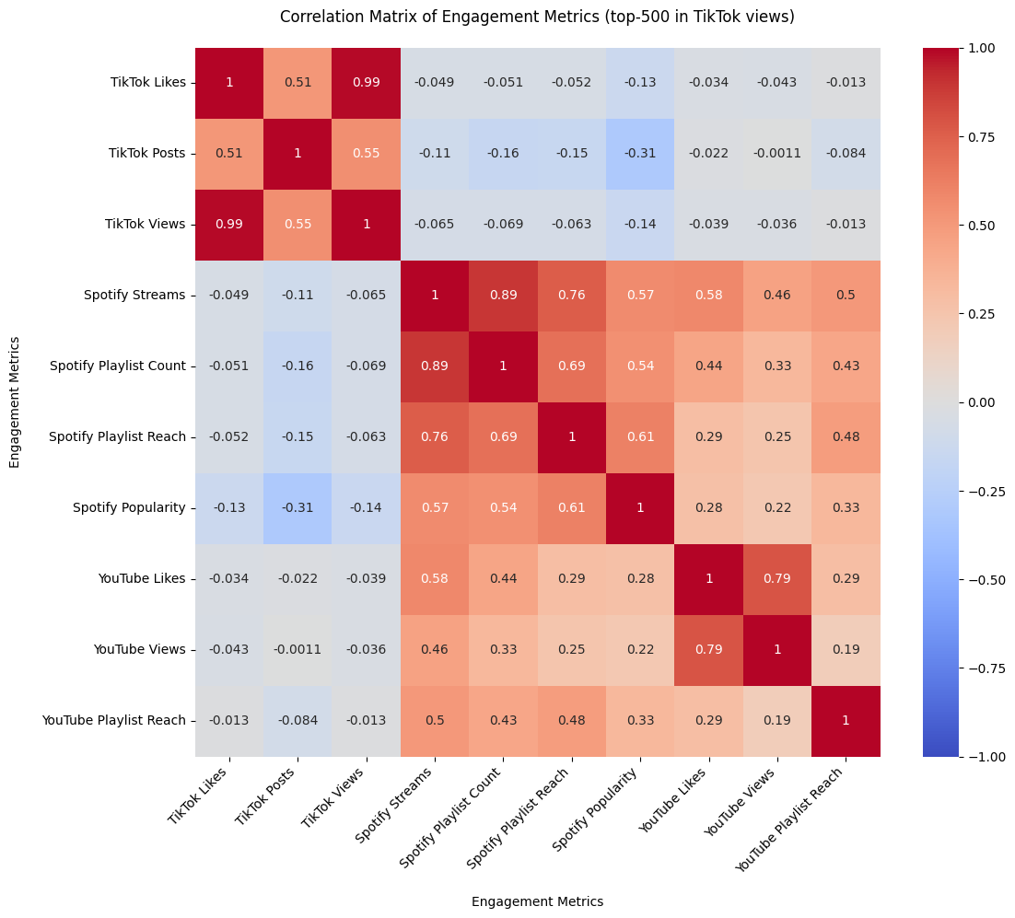

Heat Map
Notes:
UNMUTE
Quinton - after analyzing specific metrics such as likes/streams/views we decided to take a broader view of the data. So we created a heatmap to see which metrics might be positively (and negatively) correlated
Color Intensity: The darker red areas indicate strong positive correlations (closer to +1), meaning the metrics increase together.
Blue Shades: Represent negative correlations (closer to -1), meaning as one metric increases, the other tends to decrease.
Neutral (Light Colors): Values near 0 suggest little to no correlation.
Correlation Between Platforms
Strong correlations exist between *YouTube Views*, *Spotify Streams*, and *Playlist Reach*, suggesting songs that perform well on one platform tend to perform well on others.
TikTok Likes have *weak* or *negative correlations* with streaming and playlist metrics, **suggesting TikTok popularity doesn’t always translate into high Spotify or YouTube engagement**.
Platform-Specific Trends
In smaller datasets (Top-10, Top-25), *YouTube* and *Spotify* metrics show very high correlations, but as the dataset expands (Top-500), these correlations weaken, implying that mainstream hits are more universally popular across platforms, while lesser-known songs have more variable engagement.
t Influence on Streams
Spotify Playlist Count and Playlist Reach are consistently correlated with Spotify Streams, suggesting that placement in multiple playlists strongly impacts streaming numbers.

Slide 16


Key Findings
Inconsistent Impact on Streaming
Weak Correlation Between TikTok & Spotify Popularity
Virality vs. Longevity
The Power of Playlists
Platform Synergy in Big Hits
Notes:
Quinton
Inconsistent Impact on Streaming
In smaller datasets, TikTok engagement appears more impactful, but in larger datasets, this effect diminishes.
Weak Correlation Between TikTok & Spotify Popularity
Correlation coefficient: -0.0470 (TikTok Likes vs. Spotify Popularity) → No meaningful relationship.
Weak Correlation Between TikTok Likes & YouTube Likes
Though the TikTok format is more like YouTube, YouTube and Spotify allow for curated listening whereas TikTok is entertainment only. It might explain how snipping songs is not the same as enjoying music.
Virality vs. Longevity
TikTok success (Likes, Views, Posts) does not strongly correlate with sustained streaming performance.
Viral hits don’t always convert into long-term listens.
The Power of Playlists
Songs with strong playlist placements (Reach & Count) tend to perform better on streaming platforms.
Curation plays a major role in long-term success.

Slide 17

Future Directions
Genre-Specific Questions
Influence of TikTok Trends
Expand Sampling
Enhance Metadata
Overcome Data Limitations
Broaden Platform Scope
Notes:
Sarah
Expand Sampling:
Instead of focusing only on top-ranked songs (e.g., top 500, top 10), analyze a random sample of songs across different popularity tiers.
Compare trends across emerging artists vs. established artists to see if TikTok impacts them differently.
Investigate whether TikTok-driven success is sustained over time or if most viral songs experience short-lived spikes.
Enhance Metadata:
Collect additional data points, such as release date, record label, song duration, and featured artists, to identify trends beyond just streams and likes.
Explore lyrical themes, production styles, and audience engagement metrics to see if specific characteristics contribute to virality.
Use natural language processing (NLP) to analyze song lyrics for common themes in TikTok-viral tracks.
Overcome Data Limitations:
Adjust for missing data caused by Spotify API deprecations (end of 2024), which removed access to key metrics like genre, danceability, and energy levels.
Cross-reference data from alternative sources (e.g., Chartmetric, Last.fm, Genius) to fill in gaps left by Spotify’s API changes.
Consider scraping TikTok and social media insights to get a fuller picture of audience engagement beyond streaming numbers.
Broaden Platform Scope:
Expand beyond Spotify and TikTok to include Apple Music, YouTube Music, and SoundCloud for a more comprehensive view of streaming trends.
Compare the role of radio play and traditional media exposure in sustaining a song’s popularity versus digital virality.
Investigate whether different platforms favor different genres and whether marketing/ad spend influences platform-specific success.
Quinton
Genre-specific questions
Are certain genres more likely to become viral on TikTok versus trending on Spotify?
Is there is a shift in what genres are more popular between the different services?
(there's a marketing/ad spend angle there I think)
How does TikTok virality impact the performance of niche genres versus mainstream genres?
Influence of TikTok Challenge and Trends
Does the presence of a viral dance challenge significantly boost Spotify streams for a given song?
How do different TikTok trends (dance, meme, background music) affect streaming success on Spotify?

Slide 18

Thank
You
Notes:
That brings us to the end of our presentation. We want to thank you for your time and interest in our anal. We appreciate the opportunity to share our insights with you.

